Slide 1
Module 5: Sampling
5.10: Applications in R
Annie Collins
Data Sciences Institute, University of Toronto

Slide 2
survey R Package

Slide 3
Why use survey-specific packages?
The survey package allows for calculations that take into account specific elements of sampling design
These include strata, clusters, sampling units, weights, and more
Calculations can theoretically be done without using the survey package, however you will face difficulties…
Determining the appropriate steps to take to match with sample design
Ensuring accurate answers

Slide 4
survey R Package
survey is an R package designed for analysis of complex survey designs
survey does not generally work with tidyverse functions
Piping to survey functions is not often possible
Data objects of type “svydesign” cannot be directly viewed or manipulated in the same way as tibbles

Slide 5
survey Data Sets

Slide 6
Reading Data Documentation
Always read the introduction
Look for sections with names like “Sampling Design”, “Methods”, “Analysis Guidelines”, etc.
Locate and read the data dictionary for any specific variables of interest
Identify important features of sampling design
Sampling units – PSUs, SSUs, …, and the corresponding variable(s)
Strata – Definitions and corresponding variable(s)
Clusters – Definitions and corresponding variable(s)
Sampling weights – Will likely be one variable, however take note of additional types of weights used such as replicate weights (not covered here)
Finite population correction (FPC) – May be multiple variables for multiple sampling stages

Slide 7
Data Sets: api
The api data sets contains information about California public schools, namely concerning each school’s Academic Performance Index (API) score from 1999 and 2000
apipop contains information for all schools (N = 6,194)
There are several variables of varying types recorded in these data sets. The main variables are the same across data sets, and the sample data sets contain additional variables for sampling weights and finite population correction.

Slide 8
Data Sets: api
apistrat contains a stratified sample (n = 200) of all schools in apipop. The sample was stratified by school type (elementary, middle, and high school) with an SRS taken within each stratum.
apiclus2 contains a two-stage cluster sample of all schools in apipop.
PSUs: districts (n = 757)
SSUs: schools (n = 200)
Observational units are individual schools for both samples

Slide 9
Data Sets: yrbs
The yrbs data set contains information from the 2015 Youth Risk Behaviours Survey conducted by the US Centers for Disease Control
Sample size: n = 15,624
One variable containing responses to ‘Never/Rarely wore bike helmet’ in the form Yes=1, No=2
Notes:
NOTE: After this slide, instruct students to open up the documentation for the yrbs data set (data/yrbs.pdf). Ask them to identify the PSUs, SSUs, and TSUs, and what types of sampling were used. Answers on the following slide.

Slide 10
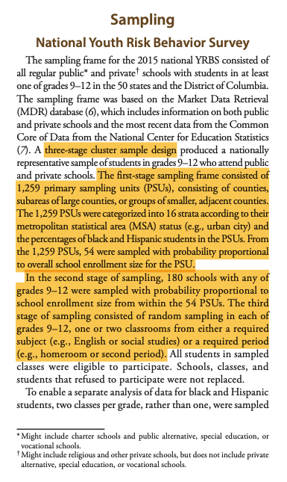
Data Sets: yrbs
PSU: counties, sub areas of large counties, or groups of smaller, adjacent counties
SSUs: schools
TSUs: classrooms
Observational units: students
Three-stage cluster sample:
Stratified sampling
Probability-proportional-to-size sampling
Simple random sampling
Notes:
NOTE: Given the complexity of the survey design, we have to account for aspects of both cluster sampling AND stratified sampling. We will have variation between strata, variation between clusters within strata, and variation within clusters

Slide 11
survey Functions: Set Up

Slide 12
survey.design Objects
survey.design objects combines a data frame and all the survey design information needed to analyse it
survey.design objects contain survey data AND information about the sampling methodology used to collect it
survey package functions work with survey.design objects, similar to tibbles or data frames in other packages
Created using the svydesign() function
Notes:
NOTE: prompt students to pull up documentation for svydesign() (?svydesign) to follow along

Slide 13
svydesign()
svydesign() specifies and creates and survey.design object
Input: a data frame and arguments specifying sampling design elements
Output: an object of type survey.design
survey.design objects take the form of nested lists. The summary() function (base R) can be useful for recalling the sampling design details of a given survey.design object

Slide 14
svydesign()
Argument | Description
ids | Required; no default Indicates cluster IDs from highest level to lowest level ~0 indicates no clusters
strata | Formula or vector specifying strata
fpc | Formula indicating finite population correction
weights | Formula or vector specifying sampling weights
data | Data frame containing survey data and variables in the formula arguments
Notes:
NOTE: There are many more arguments than this, but these are the ones specific to our examples and lab.

Slide 15
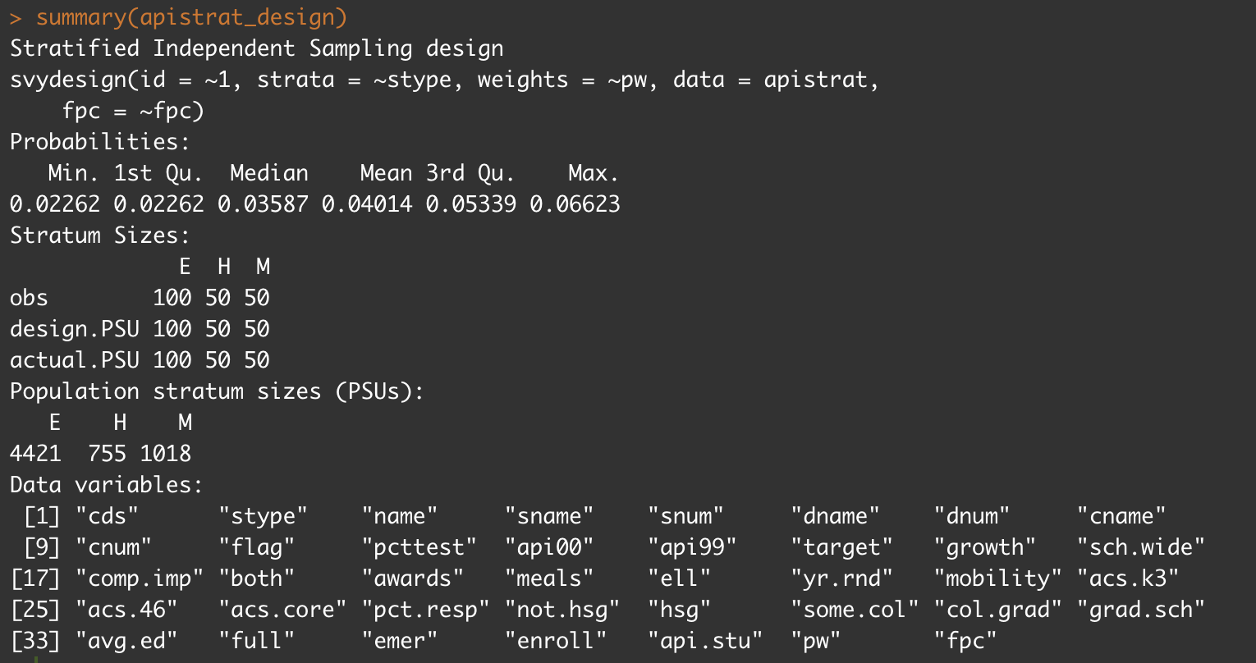
summary()
Description of sampling design
Last code used to create or update object
Distribution of sampling probabilities (1/weights)
Sample stratum sizes (n = 200)
Population stratum sizes in number of PSUs
(N = 6,194)
Variable names

Slide 16
survey Functions: Estimation

Slide 17
Estimation Functions
Estimate | Function
Mean | svymean()
Population variance | svyvar()
Total | svytotal()
Ratio (between two variables) | svyratio()

Slide 18
Estimation Functions
Syntax for svymean, svyvar, and svytotal:
svy****(x, design, na.rm=FALSE, …)
x – variable(s) to be estimated, given as their name in the data preceded by a tilde (~)
design – a survey.design object
na.rm – remove NA values from x (defaults to FALSE; if there are missing values that are not removed, the function will output NA)
… – additional arguments, not considered here

Slide 19
Estimation Functions: svyratio()
Syntax for svyratio:
svyratio(numerator, denominator, design, separate = FALSE, na.rm=FALSE, …)
numerator – numerator variable of the ratio to be estimated, given as its name in the data preceded by a tilde (~)
denominator – denominator variable of the ratio to be estimated, given as its name in the data preceded by a tilde (~)
design – a survey.design object
separate – estimate ratios separate for separate strata? (Defaults to FALSE)
na.rm – remove NA values from x? (Defaults to FALSE; if there are missing values that are not removed, the function will output NA)
… – additional arguments, not considered here

Slide 20
Estimation
By default, estimate functions output the estimate and its standard error (SE).
All functions output object of type svystat. This allows them to be further utilized with survey functions such as confint(), cv(), etc. and maintain the properties of the original sampling design.
Multiple variables can be combined with with “+”
svymean(~A+B, survey) will return the mean and SE for variable A and variable B

Slide 21
survey Functions: Subpopulation Analysis

Slide 22
Subpopulation Analysis: svyby()
Syntax for svyby():
svyby(formula, by, design, FUN, …)
formula – variable(s) to pass to FUN, given as their name in the data preceded by a tilde (~). These may change format depending on what FUN is.
by – the variables to subset by, given as their name in the data preceded by a tilde (~)
design – a survey.design object
FUN – an estimate function (svymean, svyvar, etc.)
… – other arguments not considered here. See documentation.

Slide 23
Estimation
By default, svyby() outputs the estimate and its standard error (SE). This can be changed with the vartype argument.
Outputs an object of type svyby, a data frame with the subpopulations and corresponding estimates.
Multiple variables can be combined with with “+”
svyby(~A, ~B+C, survey_design, svymean) will return the mean of A for each unique combination of variables B and C in the data. For example, if B has two categories and C has three categories, six distinct means will be returned.

Slide 24
survey Functions: Uncertainty

Slide 25
Uncertainty Functions
Metric | Function
Confidence interval | confint()
Standard error | SE()
Coefficient of variation | cv()

Slide 26
Uncertainty Functions
SE() and cv() take in svystat objects (i.e. the output of an estimate function) and output an array with the desired uncertainty measure
confint() takes in a svystat object and an additional parameter level which can be used to specify confidence level (defaults to 0.95)

Slide 27
survey Functions: Visualizations

Slide 28
Visualization Functions
The survey package is not ideal for data visualization, but it does allow you to use some functions to produce simple graphs easily and directly from svystat objects
Visualization | Function
Bar plot | barplot()
Dot chart | dotchart()
Histogram | svyhist()
Boxplot | svyboxplot()

Slide 29
Visualization Functions
Syntax for barplot():
barplot(height, beside=TRUE, …)
Syntax for dotchart():
dotchart(x, …)
height, x – results of analysis (from svymean(), svyby(), etc.)
beside – for multi-bar plots, group bars instead of stack? (Default to TRUE; not applicable for dot charts)
… – additional formatting arguments. These are documented in the graphics R package and can be accessed by using ?barplot and ?dotchart

Slide 30
Visualization Functions
Syntax for svyhist():
svyhist(formula, design, probability=TRUE,...)
formula – variable to plot. Must be preceded by a tilde (~).
design – a survey.design object
probability – Y-axis as a probability density? Default to TRUE; if FALSE, y-axis represents frequency
… – additional arguments main, xlab, ylab, etc. can be used to specify titles and axis labels. See ?hist for details.

Slide 31
Visualization Functions
Syntax for svyboxplot():
svyboxplot(formula, design, all.outliers=FALSE,...)
formula – variable to plot. Must be a two-sided formula: ~A~1 for the distribution of variable A on its own; ~A~B for the distribution of variable A grouped by variable B (B must be a factor)
design – a survey.design object
all.outliers – Show all outliers in boxplot (not just extremes)? Default to FALSE.
… – additional arguments main, xlab, ylab, etc. can be used to specify titles and axis labels. See ?bxp for details.

Slide 32
Next
5.11 Respondent-driven sampling

